Slide 1
Quantitative Methods Lecture-4

Slide 2
Probability – Part I
(Ch 4 Business Statistics, Levine et al.)

Slide 3
So far and the next
Previous Sessions
Defining and collecting data
Survey and sampling methods
Organizing and visualizing variables
Numerical descriptive measures
Today
Probability (Part I)

Slide 4
Why learn probability?
We ideally prefer certainty, however most things are uncertain.
What is uncertainty?
Faced with uncertainty, how do we make rational decisions?
Should I hire the candidate I interviewed for the job?
What is the chance of the prospective hire performing well in the job?
Should I approve the loan application on the table?
What is the chance of the loan seeker paying the loan back?
Should I do an MBA?
What is the chance of getting a better job if I invest money and 2 years in an MBA?
Study of probability helps us make sense of uncertainty
Helps us quantify “the questions about chance of an event happening”
From “perhaps” or “likely” or “unlikely” to say “50%”, “70%” or “25%”

Slide 5
Better decision can be taken if uncertainty is measured
Rain: To carry umbrella or not?
Farming: To grow Wheat or Gram in Rabi season?
Safety: To wear a helmet or not?
Insurance: To insure the shipment or not?
Stock market: Which stock to buy/sell?
International airport: Frisk the passenger at Green channel?
Quality: Accept/Reject the consignment or Inspect more parts?
Cricket: batting, betting or fielding?
Commercial Bank: How much cash to keep in the branch?
Blood Bank: How many units to keep?
Insurance: What should be the premium?
Maintenance: How many spare parts to stock?
Emergency services-1: How many Fire Engines?
Emergency services-2: How many Ambulances/Nurses in emergency?
Pizza: Number of delivery boys?

Slide 6
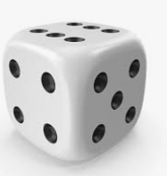
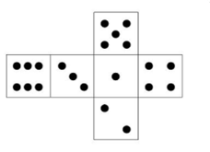
Probability
What is probability?
Chance or likelihood of an event
Random Experiment
Exact outcome can not be predicted with certainty
But outcome is always one of the possible knowns
Sample space: Contains all possible outcomes/events
Natural Experiment: Chance of rain for example
Simple event and joint events
One feature v/s more than one features
Will it be a 4? Will it be 4 & 2 on two consecutive rolls?

Slide 7
Probability
Probability is a number assigned to an event
Represents likelihood of that event happening
Always between 0 and 1
Total probability law
Total probability of all events in the sample space is 1
∑p_{i} = 1, where p_{i} = The probability of the event ‘i’
Example:
If a sample space has 6 possible events (E1, E2, …., E6)
Can a probability of getting a 2 (E2) be -1.2? Or 2?
Total probability of E1 through E6 = ∑E_{i} = 1
If the total probability of getting 1, 2, 3, 4 or 5 is 4/6, then
What is the probability of E6?
1 – 4/6= 2/6 (It’s a loaded dice not a fair one)

Slide 8
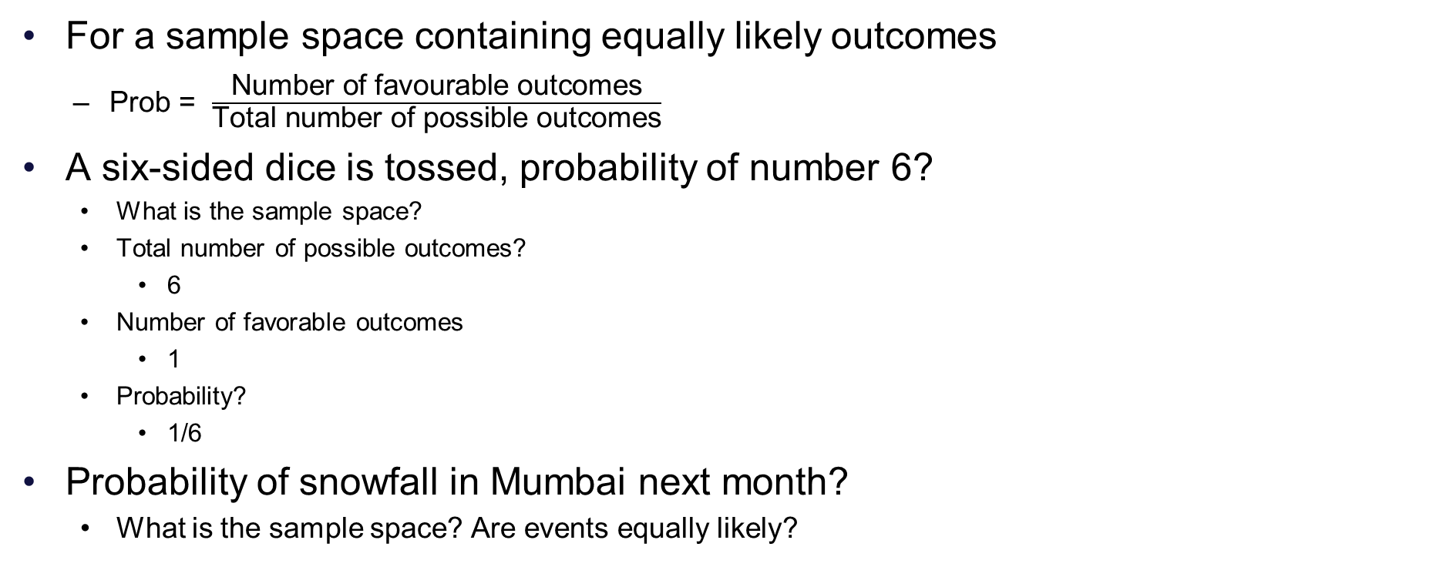
Probability?
For a sample space containing equally likely outcomes
Prob = $\frac{\text{N}\text{umber} \text{of} \text{favourable} \text{outcomes}}{\text{T}\text{otal} \text{number} \text{of} \text{possible} \text{outcomes}}$
A six-sided dice is tossed, probability of number 6?
What is the sample space?
Total number of possible outcomes?
6
Number of favorable outcomes
1
Probability?
1/6
Probability of snowfall in Mumbai next month?
What is the sample space? Are events equally likely?

Slide 9
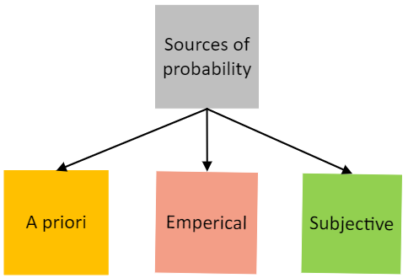
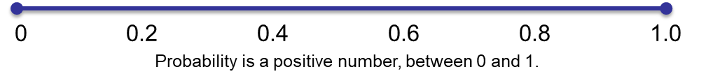
Getting values of probability
A priori
Classical/Equi-likely.
Textbook examples of Coin tossing, Playing cards, etc, or when you know nothing.
Empirical
From historical data, observations, or experiments.
Life tables in insurance, earthquakes, rainfall, twins, quality, stock market …
Subjective
Personal judgement.
Outcome of India vs Brazil cricket match outcome. Covid-19 will be completely over in 2028…

Slide 10
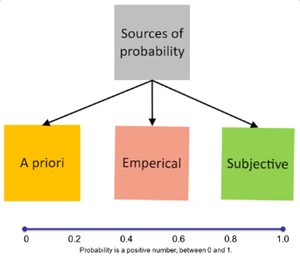
A priori probability

Slide 11
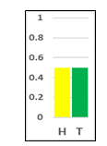

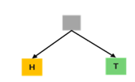


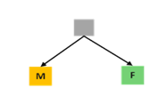


Probability- a priori
$$Probability=\frac{Number of outcomes in which the event occurs}{Total number of possible outcomes}$$
Tossing a coin-
Outcomes- Head or Tail.
P(Head) = P(Tail) = ½.
Births-
Outcomes- Male or Female.
P(Male)=P(Female)= ½.
Playing cards-
Outcomes- 26 Black or 26 Red.
P(Red)= P(Black)= 26/52 = ½.

Slide 12
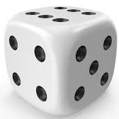

Probability- a priori …1
Number of outcomes in which the event occurs Total number of possible outcomes
P(4)=1/6. 1 1, 2, 3, 4, 5, 6.
P(5)= 1/6. 1 1, 2, 3, 4, 5, 6.
P(Even)= 3/6. 3 1, 2, 3, 4, 5, 6.
P(<5)= 4/6. 4 1, 2, 3, 4, 5, 6.
P(<=5)= 5/6. 5 1, 2, 3, 4, 5, 6.
P(Divisible by 3)= 2/6. 2 1, 2, 3, 4, 5, 6.
P(Divisible by 5)= 1/6. 1 1, 2, 3, 4, 5, 6.
P(Prime)= 3/6. 3 1, 2, 3, 4, 5, 6.

Slide 13
Empirical probability-
From experiments or observations

Slide 14
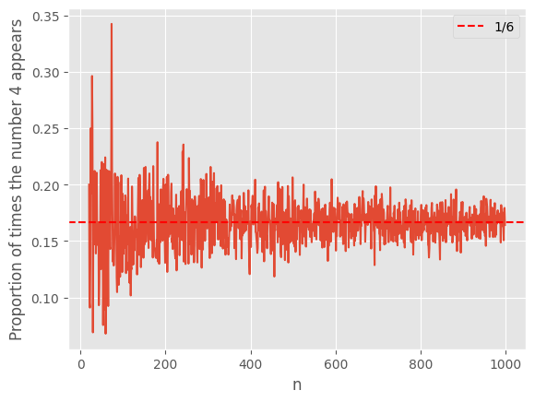
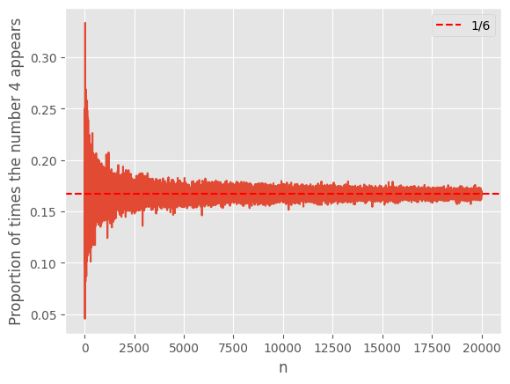
Empirical Probability
The probability is computed from experiments, observations, surveys, etc.
Proportion of times an event occurs
If a dice is rolled 10, 100, 500 or 1000 times
Actual proportion of times a 4 would appear
Will it be 1/6 or 0.167?
Empirical Test (Simulating rolls of a dice)
# Get a random number between 1 and 6. Do this 'n' times
# Calculate the proportion of times the number was 4.
# Now vary 'n' between 20 and 1000
# Chart n on the x-axis and the proportion prop on the y-axis.
Python code is shared on the teams files

Slide 15
Empirical probability Examples
The probability is computed from experiments, observations, surveys, etc.
Item | Probability
Left-handed | 1 : 10 persons
Twins | 3 : 100 births
Breast Cancer | 1 : 8 Women in US
Lung Cancer | 17.2 in 100 male smokers 11.6 in 100 females smokers

Slide 16
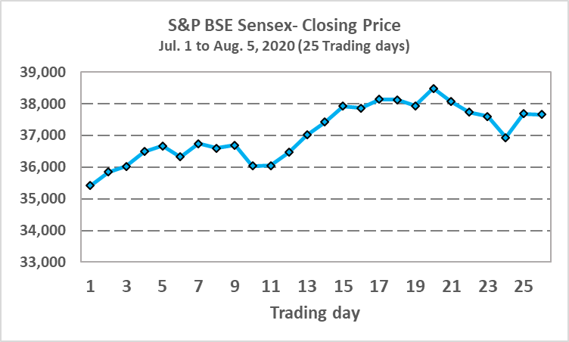
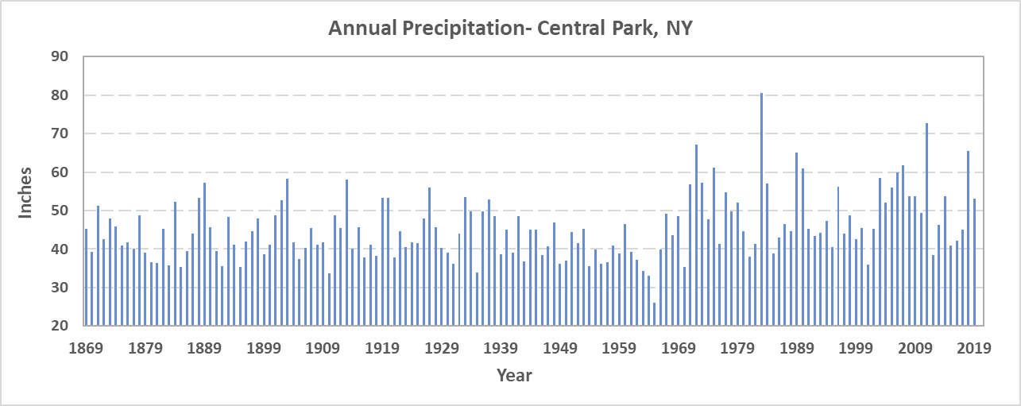
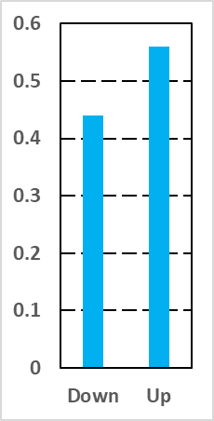
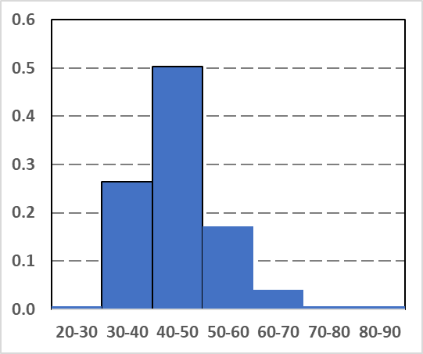
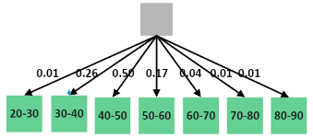
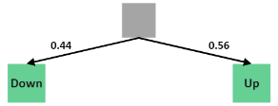
Empirical probability computation- Examples
.
S&P BSE Sensex observed for 26 days- 11 times Down and 14 times Up.
P(Down) = 11/25 = 44%.
P(Up) = 14/25 = 56%.

Slide 17


Using probability to make decisions: Expected value
Expected value: E[X] = ∑x_{i}p(x_{i})
x_{i} = The values X takes
p(xi) = The probability that X takes value x_{i}
∑x_{i}p(x_{i}) = x₁p(x₁) + x₂p(x_{n}) + … + x_{n}p(x_{n})
n: Total number or possible outcomes
For Roulette-A
Probability of Blue, Yellow, Red and Green is 9%, 6%, 70% and 15% Respectively
You are offered Rs 10 for Blue, Rs 20 for Yellow ,Rs 30 for Red and Rs 40 for Green
Game Fee is Rs 30
Should you play this game? Should you offer this game?
Expected value E[X]: x1p(x1) + x2p(x2) + x3p(x3) + x4p(x3)
10*0.09 + 20*0.06 + 30*0.70 + 40*0.15 = 0.9 + 1.2 + 21 + 6 = 29.1
Note: Only likely to hold in large number of trials

Slide 18
Subjective probability

Slide 19
Subjective probability
Past experience, personal opinions and biases, etc.
1. Covid-19 will be over completely over by 2028-
ExpertA = 0.90. ExpertB = 0.10. ExpertC = 0.25. Layman = 0.30.
BSE Sensex will close 400-500 points up tomorrow-
Broker-A: 0.40. Broker-B: 0.30. Investor-A: 0.60. MF-A: 0.30.
Sports betting-
P(IndiaWillWin) = 0.40. BookieA.
P(IndiaiWillWin) = 0.45. BookieB.
P(IndiaWillWins) = 0.70. BookieC.

Slide 20
Types of probability- for two or more events

Slide 21
Joint and Marginal probability

Slide 22
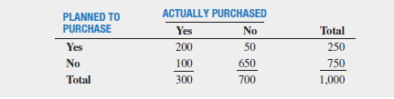
Joint Events
M&R Electronics case from the book
Purchase behavior of 1000 households
HDTV
What is the sample space?
Related to purchase behavior of 1000 households
Depends on how you frame the experiment
Simple events? (Only one characteristic)
A household planned to purchase, did not plan to purchase, actually purchased, did not actually purchase
Joint events? (More than one characteristics)
Planned to purchase and actually purchased

Slide 23
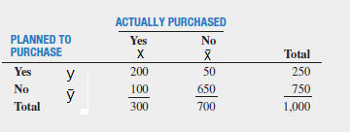
Joint Events
Simple probability
p(y) = p (planned to purchase)
250/1000 = ¼ = 0.25
Complement
p( did not plan to purchase) = p(ȳ ) = 1 – p(y)
0.75
Joint Probability:
P (planned to purchase & actually purchased) = p(x and Y)
200/1000 = 1/5 = 0.2
p(x ∩ Y) ; ∩ : Intersection symbol
Addition Rule
p(x or y) = p(x U y) = p(x) + p(y) – p(x∩y)
U: Union symbol
Contingency Table
y
250
x
(300)
x ∩ y
200
Venn Diagram

Slide 24
Marginal Probability
Marginal Probability
Event A occurs with one or other events B1, B2, B3…. Bn
Marginal probability of A: P(A()
Sum of joint probabilities with all B1, B2, …. Bn
P(A) = P( A and B1) + P (A and B2) +….= P(A and Bn)
B1, B2, …, Bn are mutually exclusive and collectively exhaustive events occurring with event A
Contingency Table
P(y) = p (y ∩ x) + p (y ∩ X̄)
200/1000 + 50/1000
= 0.2 + .05 = 0.25

Slide 25
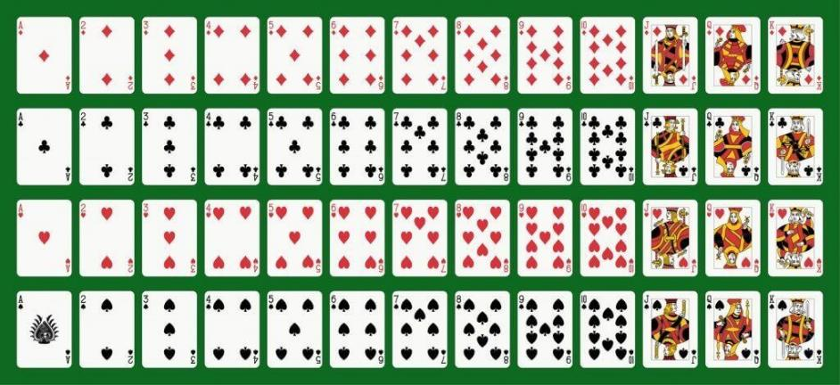
Marginal and Joint…1
Marginal
P(Red)=
1/2
P(King)=
1/13 = 4/52
P(7) =
1/13
P(Picture) =
12/52
P(Diamond)
13/52 = 1/4
Joint
P(Red and King)
2/52
P(Diamond and Red)
13/52
P(Picture and Red)
6/52
P(Black and Red)
0
P( <3 and Red)
4/52
Diamond
Club
Heart
Spade
Marginal probability- only one event occurs. P(Red) means the probability that the card is of Red color.
Joint probability- both events occur. P(Red and King) means the probability that the card is of Red color and its is also a King.

Slide 26
Marginal and Joint probability…2
Marginal
P(Red)= 26/52 = 1/2.
P(King)= 4/52.
P(7) = 4/52.
P(Picture) = 12/52.
P(Diamond) = 13/52.
Joint
P(Red and King) = 2/52.
P(Diamond and Red) = 13/52.
P(Picture and Red) = 6/52.
P(Black and Red) = 0/52.
P( <3 and Red) = 4/52.
Diamond
Club
Heart
Spade
Marginal probability- only one event occurs. P(Red) means the probability that the card is of Red color.
Joint probability- both events occur. P(Red and King) means the probability that the card is of Red color and it is also a King.

Slide 27
Q&A

